Slide 1
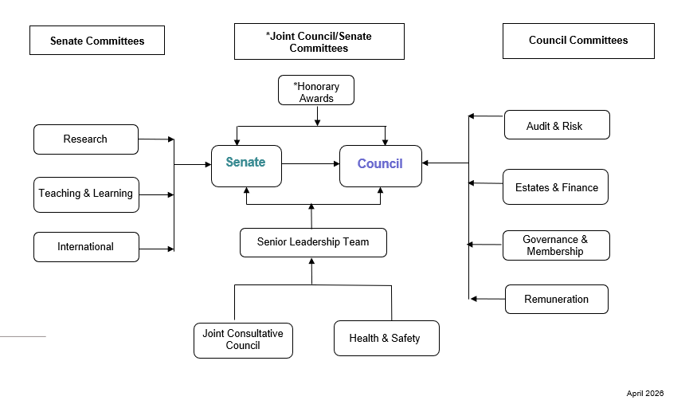
Committee Structure
Notes:
These are our reference points and we map our institutional regs and processes against these to maintain compliance

